Slide 1
The Efficacy of Finetuning Large Language Models for Interpersonal Conflict Resolution
Matthew Boraske mb1020923@wcupa.edu
Faculty Advisor: Dr. Richard Burns
rburns@wcupa.edu

Slide 2
01
Overview
Introduction to LLMs and Interpersonal Conflict Resolution
The Reddit AITA Datasets
Finetuning Methodology for Flan-T5-XXL and Llama-2-13B-Chat
Changes in Performance due to Finetuning
Recommended LLM Architecture and Finetuning Methodology
Conclusions and Future Work

Slide 3
01
Introduction
What are Large Language Models (LLMs)
and how are they being used?
What is interpersonal conflict resolution and why is it hard for LLMs?
What are the contributions of this research?

Slide 4
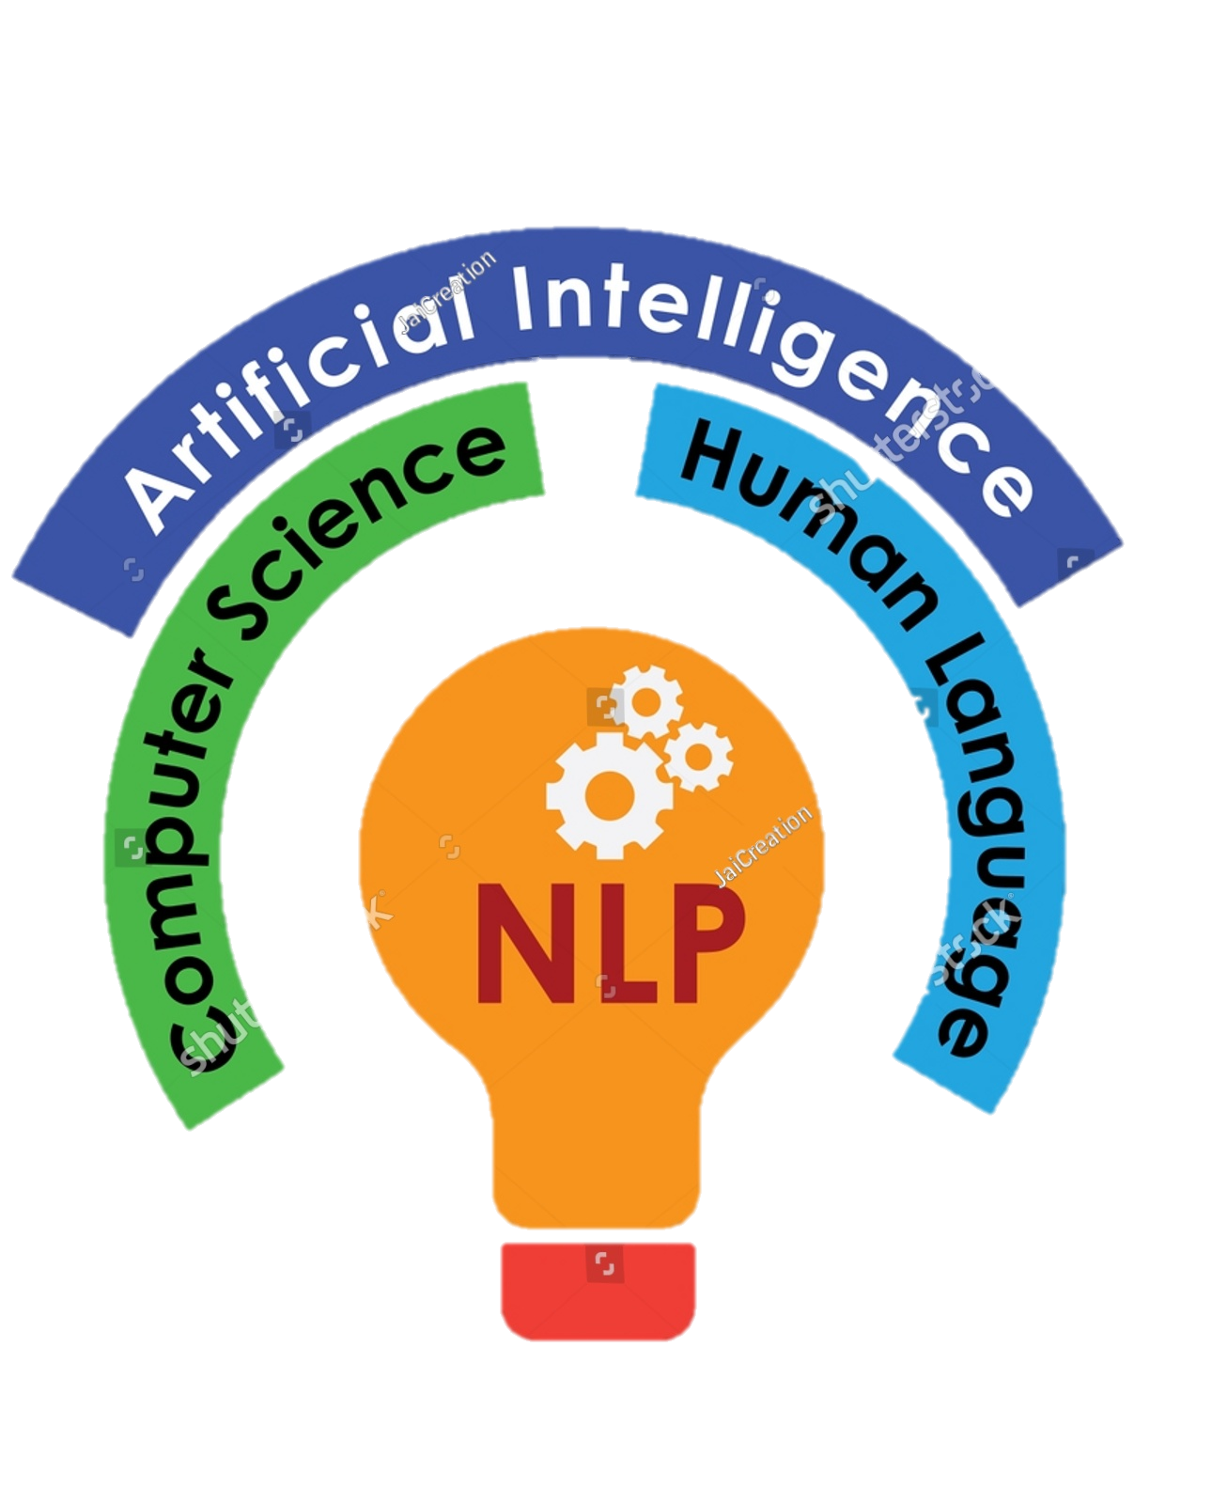
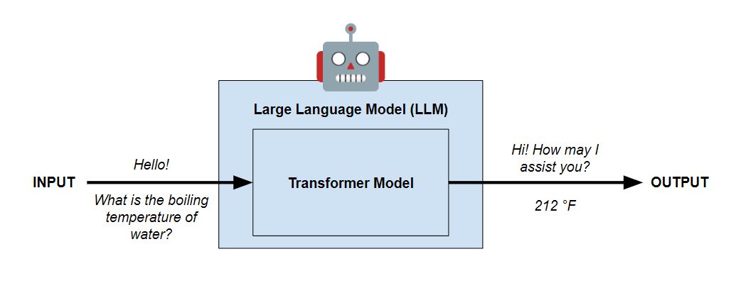
What is a Large Language Model (LLM)?
Artificial intelligence (AI) systems trained on extensive textual datasets to generate, understand, and interact with human language in a contextually appropriate manner.
Natural Language Processing (NLP)
But how are LLMs implemented?
… since 2017, via the transformer architecture!

Slide 5
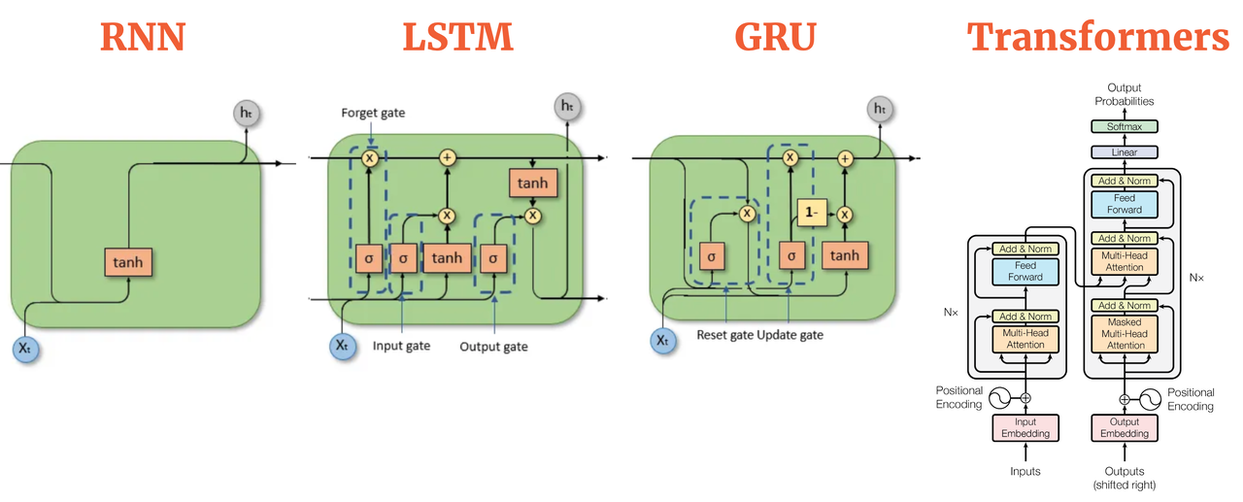
Attention: The Key to The Transformer
Previously SOTA model for natural language processing (NLP) was Recurrent Neural Networks (RNNs) which learned relationships between elements in a sequential manner.
RNNs are limited in learning complex relationship in larger texts due to the vanishing gradient problem.
The attention mechanism in transformer models allows it to selectively focus on different parts of the input sequence when generating each output, enabling it to capture long-range dependencies and relationships in parallel.
By attending to all positions in parallel, transformers directly learn relationships between any pair of tokens (pieces of text), regardless of their sequential distance
The Evolution of LLM Architectures
[1]

Slide 6

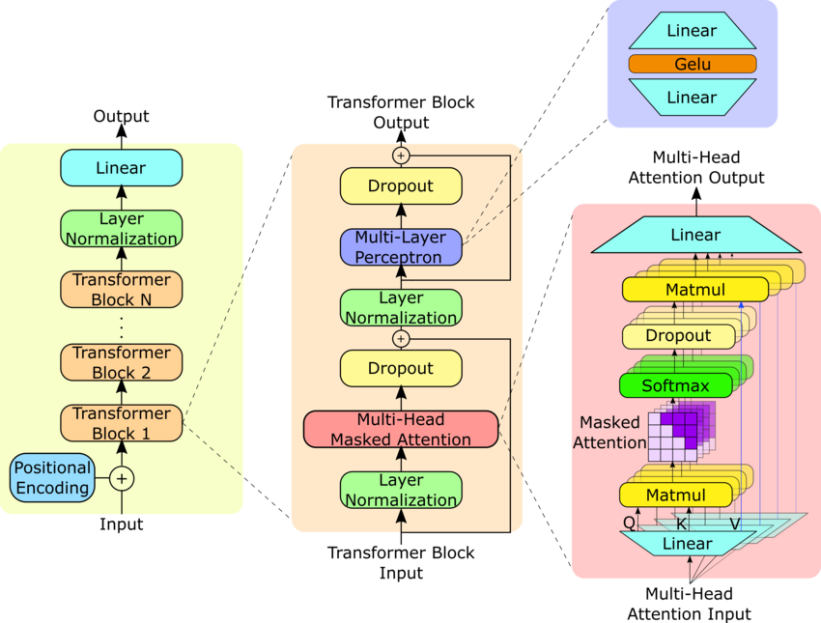
The Two Types of Transformers
Encoder-Decoder (2017)
Decoder-only (2019)
Decoder
Decoder
Encoder
[2]
GPT Architecture
[3]
Original Transformer Architecture

Slide 7
Encoder-Decoder
Predicted Token
Introduced by Vaswani et al. in 2017.
Based on sequence-to-sequence translation, where the encoder converts the input sequence into a fixed-length context vector, which is used by the decoder via a cross-attention mechanism
Computes multiple self-attention operations in parallel, allowing the model to attend to different aspects of the input sequence simultaneously.
- Encoder-decoder models have access to the entire input sequence. The encoder self-attention mechanism allows each token to attend to all other tokens in the sequence, regardless of their position.
Cross-attention mechanism
Decoder
Encoder
If not
EOS token
[1]
Begins with BOS Token

Slide 8
Decoder-only
- Introduced by Radford et al. in 2019 via the Generative Pretrained Transformer (GPT)
- Based on casual language modeling, where the goal is to predict the next token in a sequence given all the previous tokens.
- When generating text using a decoder-only LLM, only the portion of the sequence that the model has seen so far is considered as context (it can't attend to future tokens)
- This can be problematic if the optimal response requires knowledge contained in future context.
Predicted token
Decoder
If not
EOS token
Begins with last token in input sequence
[2]

Slide 9
Why are Transformers Ideal for LLMs?
They are very scalable!
Why do we want to scale up LLMs?
Improved understanding in learning complex relationships
Improved performance on downstream tasks
Better at learning from less data
Able to handle larger vocabulary sizes and context window, which is the amount of information that is considered when generating the next token
Transformers can scale in 4 ways
Increase # of encoder or/and decoder layers
Increase # of attention + feed-forward layer pairs
Increase # of hidden layers in each feed-forward layer
Increase size (# of neurons) in each hidden layer
Level
Within
Architecture

Slide 10


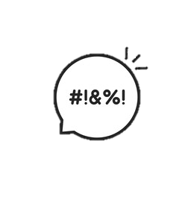
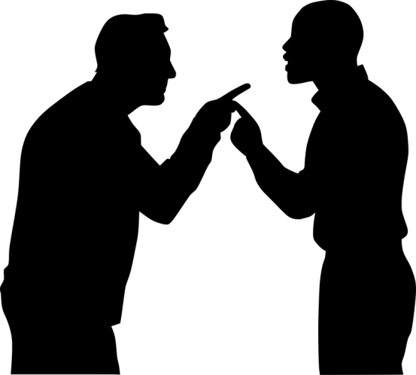

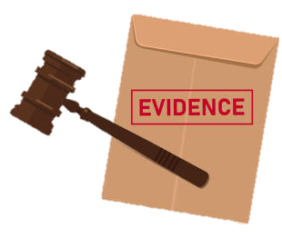
Breaking down Interpersonal Conflict Resolution
Why is this challenging for AI?
Ambiguity
Toxicity
Human Biases
What is it?
What does interpersonal conflict resolution look like in practice?
A classification of behavior
A justification for this classification
Relationship problems!

Slide 11
What transformer architecture should LLMs utilize for interpersonal conflict resolution?
Two Pressing Questions to Address
Adapting a pre-trained LLM to a downstream task by training it on a smaller task-specific dataset
A finetuned model combines pre-trained knowledge with task-specific knowledge
What finetuning techniques should we apply to create an optimal AI agent?

Slide 12


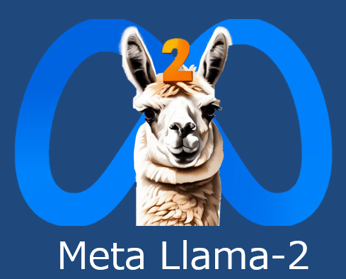

Experimentation on a Real-Life Data
Example Input
Encoder-Decoder LLM
“I (f34) bought my boyfriend (m32) a 2018 MacBook Air … Two days ago, he got annoyed at me that I asked him to come to bed (it was 2 am), slammed the laptop shut and came. Then, he discovered the next day that his slamming the laptop shut broke the screen. He started demanding that I pay for it because "I provoked him" … AITA?”
Instruction Finetuning on
Interpersonal Conflict Dataset
Example Output
Finetuned Model
NTA. That is classic manipulative behavior. I'd watch out that he doesn't continue to blame you for his actions.
Decoder-only LLM
Classification
Justification
r/amithea**hole
(AITA)

Slide 13
02
The Reddit AITA Datasets
How was the data collected, prepared, and analyzed for instruction finetuning?

Slide 14

Dataset Creation
Filtering for submissions that have…
1. a high community score
2. significant engagement.
1,688,066
Submissions
Score = Upvotes - Downvotes
50+ score
High Quality Submissions and Their Top 10 Comments
72,119,169
Comments
10+ score
r/amithea**hole
2019-2022
Pushshift API
4 Unique AITA Datasets
Reddit AITA Multiclass Top 2K
Reddit AITA Multiclass
Reddit AITA Multiclass
Reddit AITA Multiclass
Filtering by score
Filtering by score
Stratified
to contain equal classes
Stratified
to contain equal classes
NTA
NAH
ESH
NTA
NAH
ESH
NTA
YTA
NTA
YTA
INFO
YTA
INFO
YTA

Slide 15
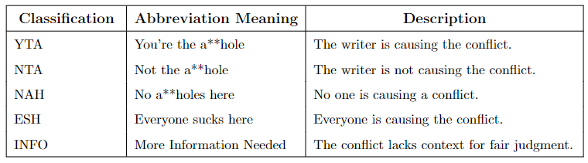

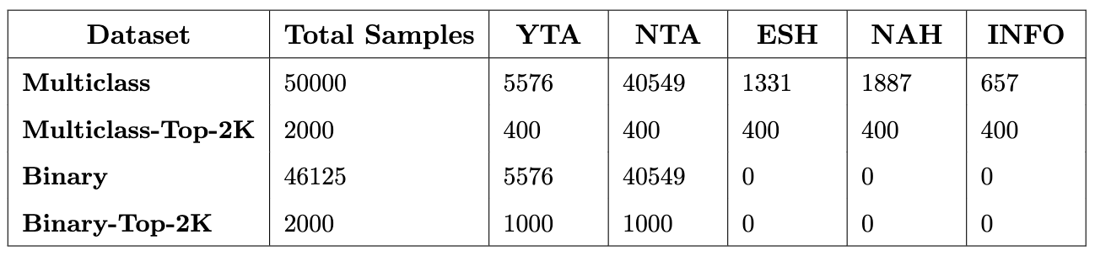
Datasets publicly released on HuggingFace

Slide 16
Dataset Analysis
Ambiguity
Toxicity
?
?
?
Commenter Disagreement
Derogatory, vulgar, and racist, and bigoted language

Slide 17
Ambiguity Analysis
Disagreement between commenter AITA classifications
can be evaluated on three different levels
Holistic
Pair-wise
Intra-sample
All ten commenters across entire dataset
Pairs of commenters across entire dataset
Classifications the ten commenters within each sample
Krippendorff’s Alpha
Cohen’s
Kappa
Custom
Ambiguity Score

Slide 18
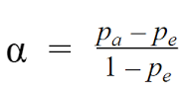
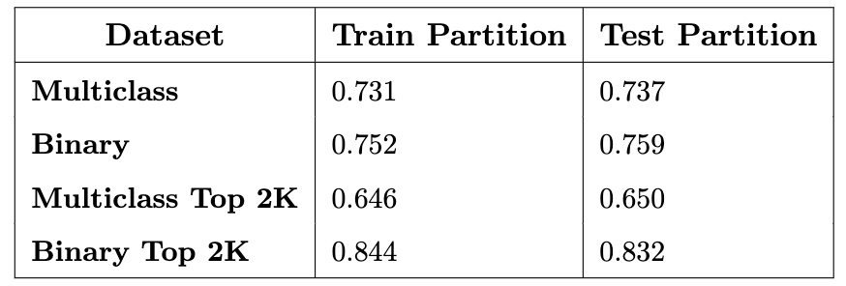
Holistic Commenter Agreement (Krippendorff’s Alpha)
Measures inter-rater reliability, or how much homogeneity, or consensus, there is in given ratings.
Can be used for any number of raters >= 2
[4]
α (Alpha): Krippendorff's alpha.
p₀ : The observed agreement among raters, aka the proportion of times that the raters agree, relative to what would be expected by chance.
p_{e} : The expected agreement by random chance
Scores below 0.8 signal moderate disagreement.

Slide 19
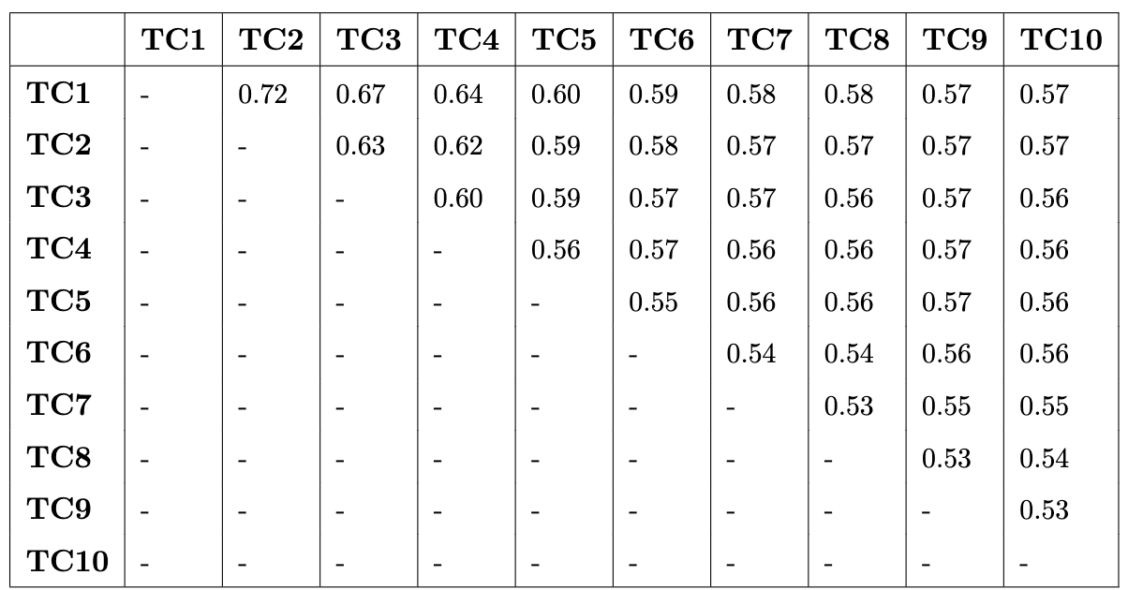
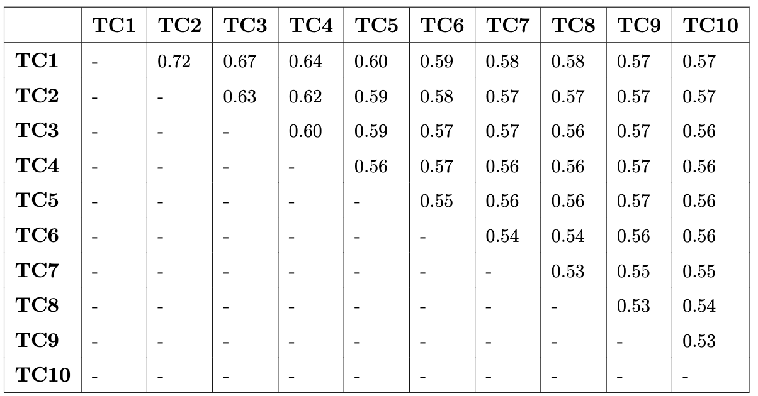
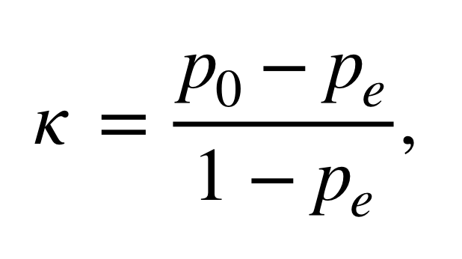
Pairwise Commenter Agreement (Cohen’s Kappa)
Similar to Krippendorrf’s alpha, but measures agreement between two raters only.
Scores below 0.75 indicate moderate disagreement.
Reddit AITA Multiclass
Κ: Cohen’s Kappa
P₀ ​: The observed agreement between the two raters.
P_{e} : The expected agreement by random chance.
[5]
Reddit AITA Binary

Slide 20
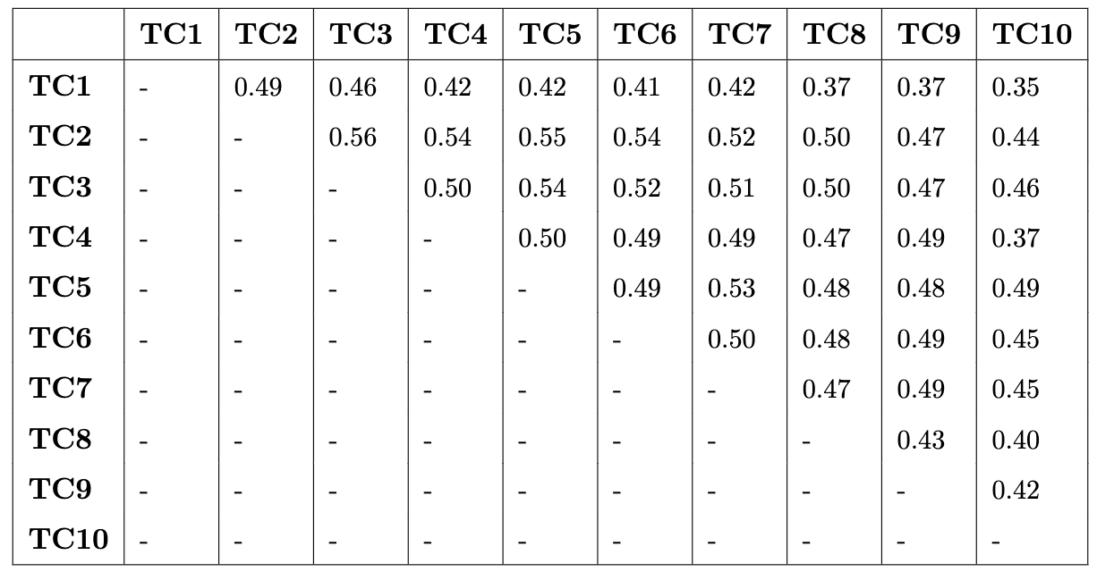
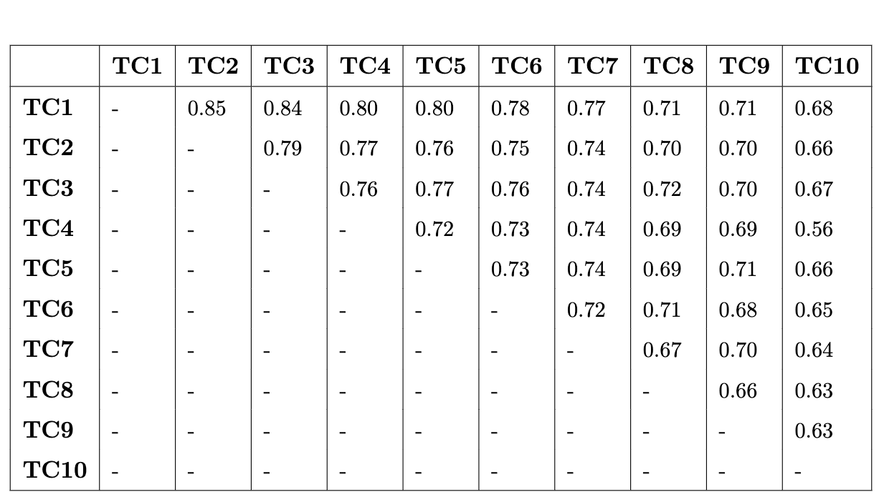
Reddit AITA Multiclass Top 2K
Cohen’s Kappa Scores
Reddit AITA Binary Top 2K
Cohen’s Kappa Scores
Scores below 0.75 indicate moderate disagreement.
Scores below 0.40 indicate
major disagreement.

Slide 21
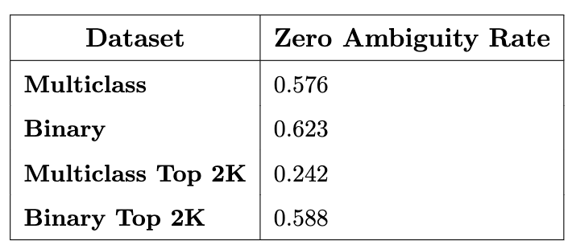
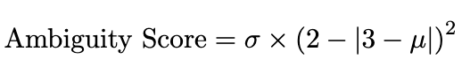
Intra-Sample Commenter Agreement (Ambiguity Score)
AITA
Classification
Ambiguity
Score
Custom metric that calculates the agreement between the raters within a sample
Designed to account for the fact that some classifications are more similar than others.
Normalized so that zero represents no ambiguity and one represents complete ambiguity
YTA
ESH
INFO
NAH
NTA
1
2
3
4
5
Similarity
Each of the ten classification is encoded into its integer score
σ: Standard deviation
μ: Mean

Slide 22
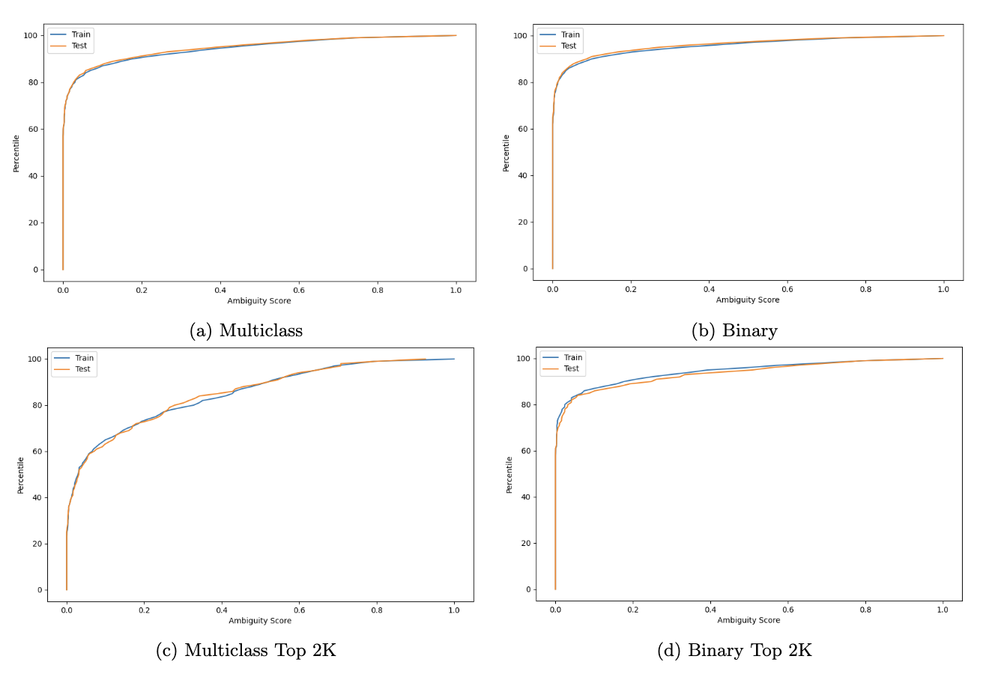
At least some degree of disagreement between commenter classifications within samples for …
- 42.4% of Multiclass dataset
- 37.3% of Binary dataset
- 75.8% of Multiclass Top 2K
- 41.2% of Binary Top 2K

Slide 23
Bringing it all together…
Commenter Agreement
Holistic
Pair-wise
Intra-sample
All ten commenters across entire dataset
Pairs of commenters across entire dataset
Classifications the ten commenters within each sample
Krippendorff’s Alpha
Cohen’s
Kappa
Custom
Ambiguity Score
Moderate Disagreement (Ambiguity) Between Commenters on All Levels

Slide 24
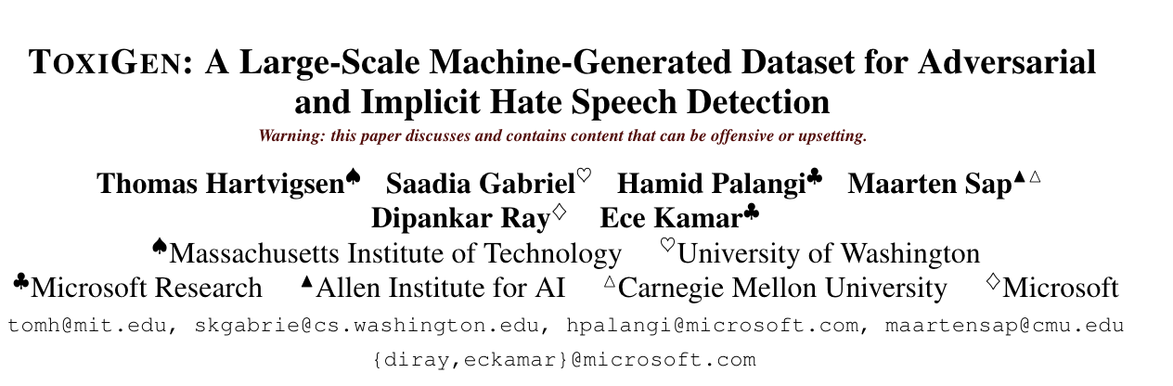
Toxicity Analysis
Reddit AITA Dataset
Utilized a RoBERTa model finetuned on the Toxigen dataset, which contains 274k samples of toxic and benign sentences mentioning thirteen minority groups
Each sample is evaluated for toxicity
Toxigen RoBERTa
Generates a classification
and confidence score
Toxic
Benign
Published at ACL (Association for Computation Linguistics) 2022
1
1
0.5

Slide 25
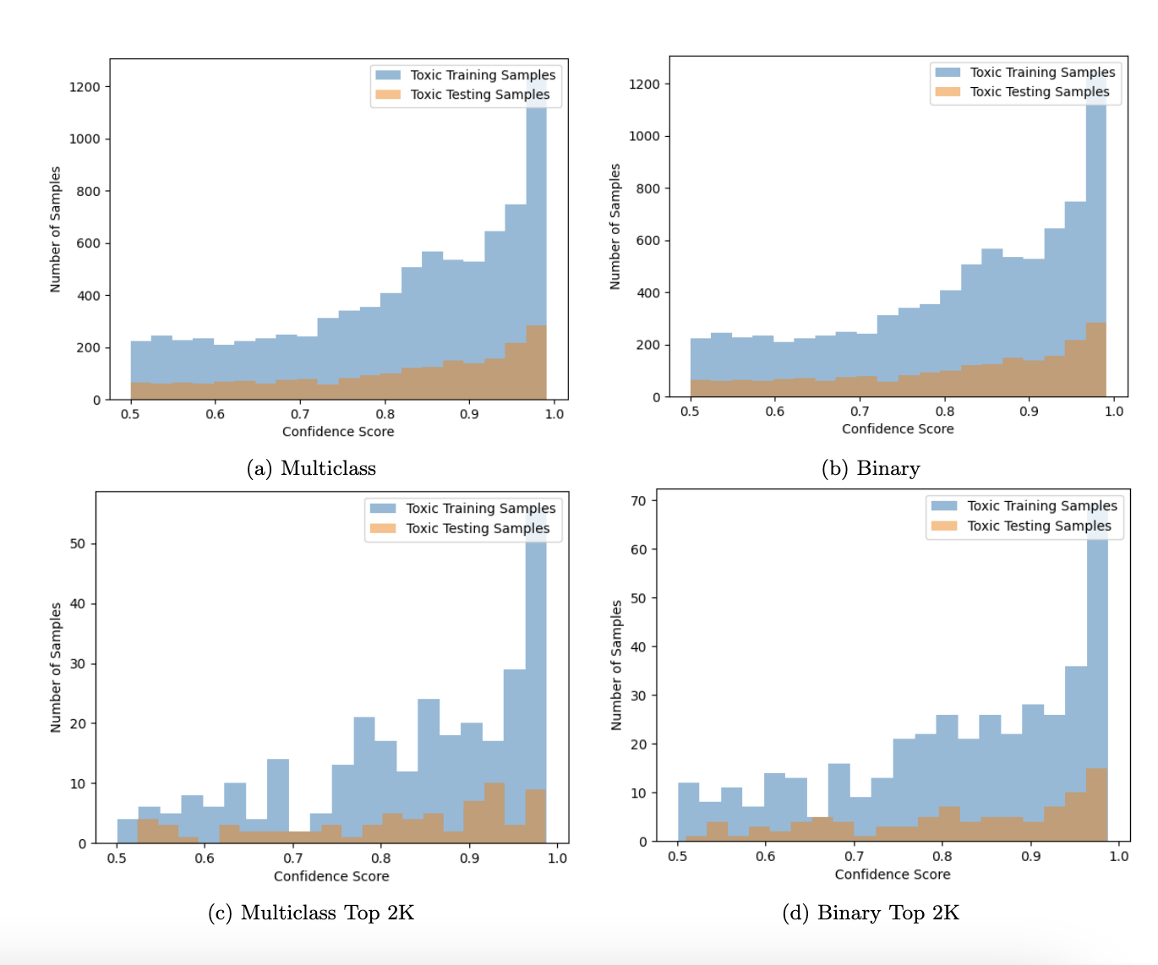
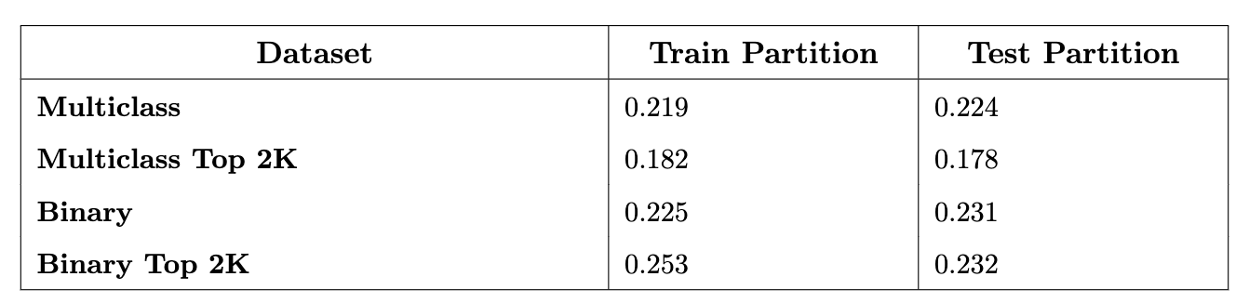
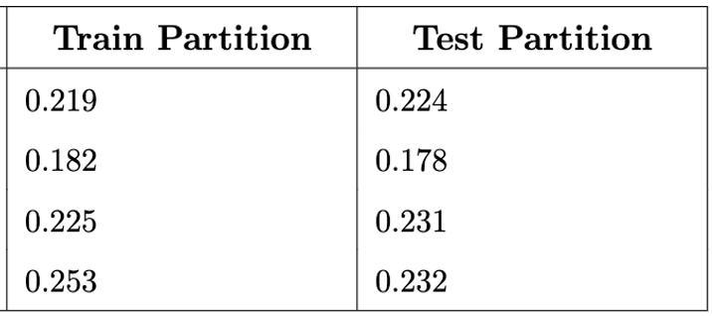
Approximately a fifth of all samples in each dataset were classified as toxic

Slide 26
Insights from Dataset Analysis
Four Reddit AITA Datasets
Are the behavior classifications ambiguous?
Yes
Do the samples contain toxic language?
Yes
These qualities imply that the samples are fair representatives of real-life interpersonal conflicts.
How can we mitigate the issues that appear
when training on data with these qualities?

Slide 27
03
Finetuning Procedure
What considerations were taken to facilitate finetuning?
How was instruction finetuning completed for Flan-T5 (encoder-decoder) versus Llama-2-Chat (decoder-only)?
How methods were used to complete finetuning?

Slide 28
Context Window Consideration
The amount of information that is considered when generating the next token
Encoder: 1024 tokens
Decoder: 256 tokens
4096 tokens
Do all the input sequences (instruction + submission texts) fit within these context windows?

Slide 29
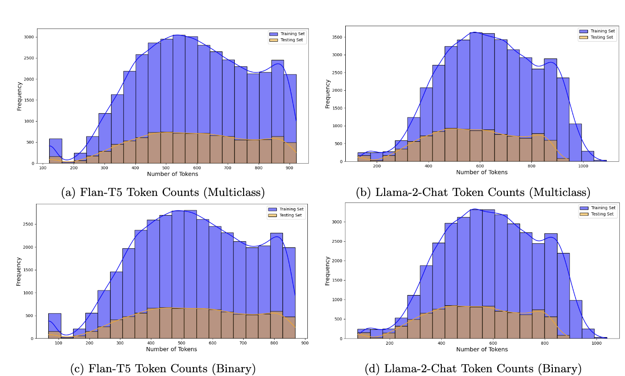

Slide 30
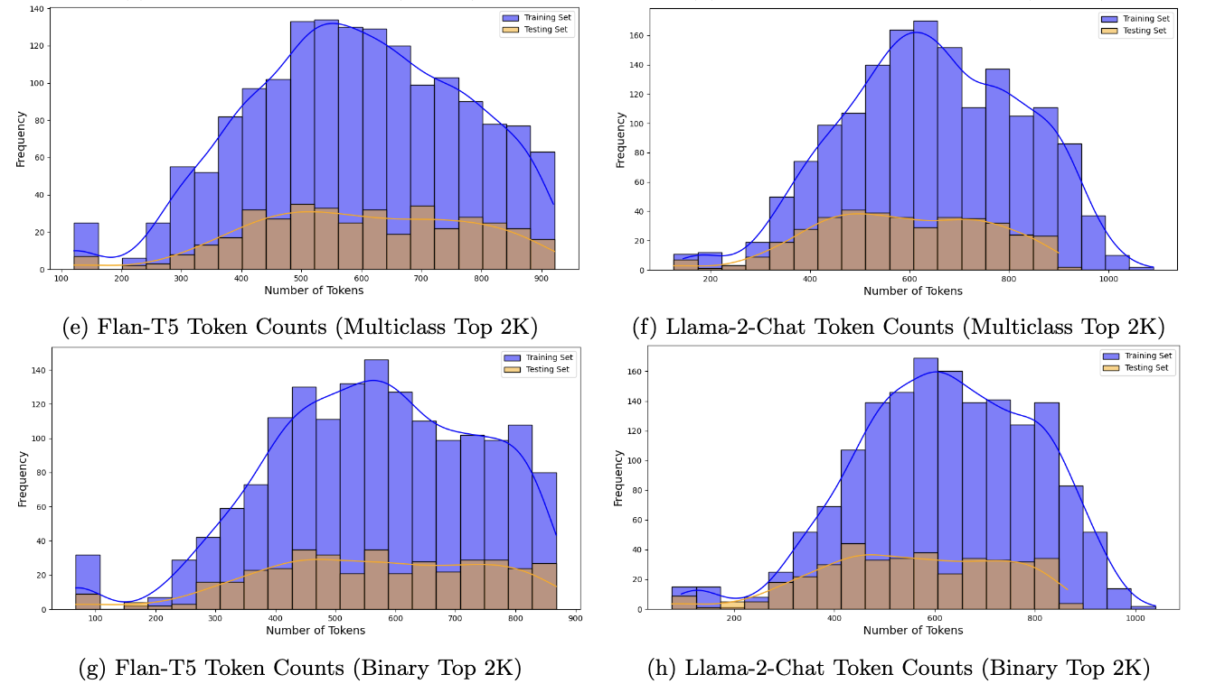

Slide 31
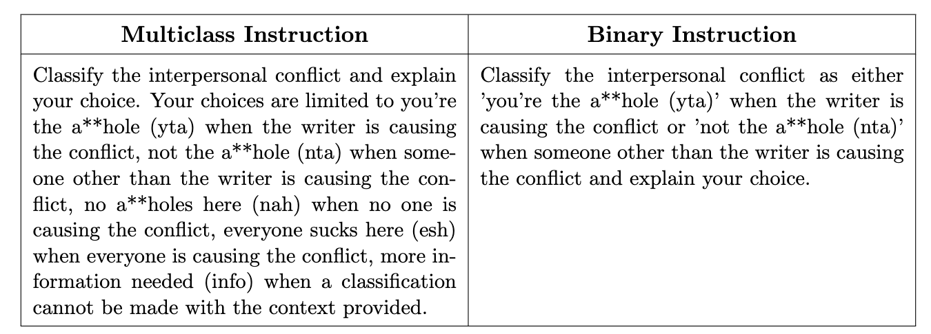
Instruction Finetuning
To adapt a model to behave in a certain manner, an instruction can be added to each sample in the finetuning data
Flan-T5 Input: Instruction + Sample Input
Llama-2-Chat: <s>[INST] <<SYS>> {Instruction} <</SYS>> {Sample Input} [/INST]

Slide 32
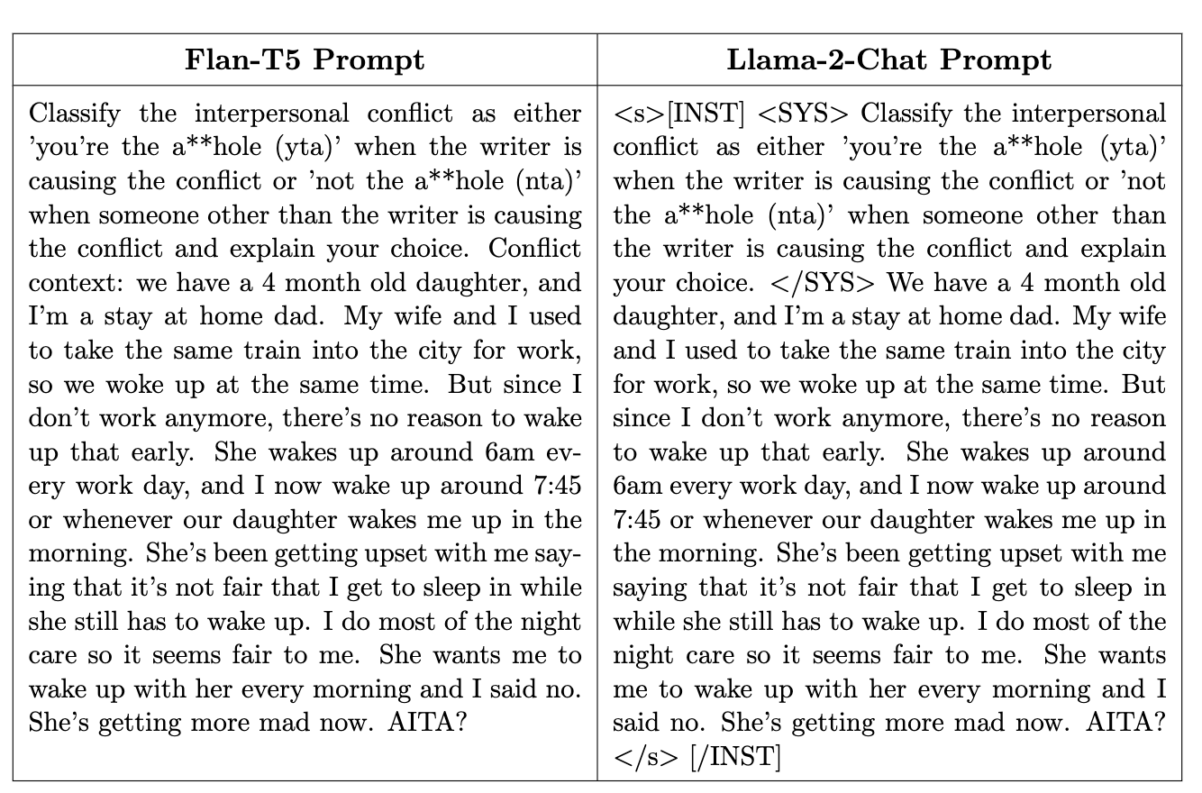
Example Flan-T5 and Llama-2-Chat Prompts

Slide 33
QLoRA
How was the finetuning completed?

Slide 34
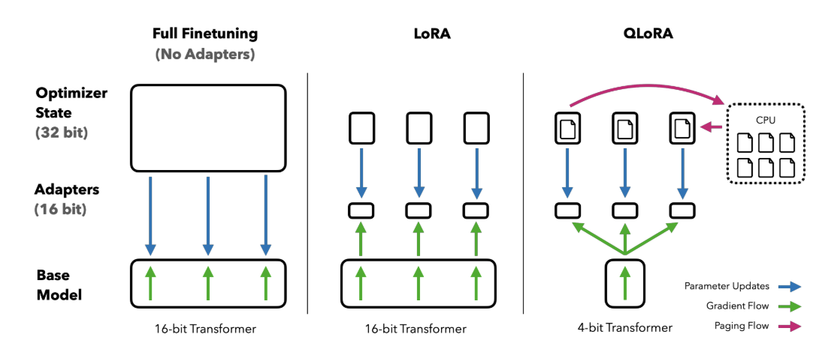
QLoRA (Quantized Low Rank Adaption)
Allows for the efficient finetuning of quantized 4-bit models without performance degradation
During the training process, larger weight matrices are quantized into low-rank matrices. These are learned and subsequently applied to the original weight matrices via multiplication and addition. The primary model weights are not trained.
Methods exist to merge these low rank matrices with the larger weight matrices
Using QLoRA, one can fine-tune a 65B parameter model on a single 48GB GPU, a task which previously required 780 GB of memory.
Using QLoRA allowed us to train all the Flan-T5-XXL and Llama-2-13B-Chat models on a single Nvidia L40 GPU which has 48GB of memory.
Flan-T5-XXL: 11.3B parameters
Llama-2-13B-Chat: 13B parameters

Slide 35
04
Finetuning Results
Which model was more effective at learning the AITA interpersonal conflict resolution task?
How resistive was each model to generating toxic language after finetuning?
Can the models effectively learn the task when finetuned on the smaller, two-thousand sample datasets?

Slide 36
Finetuning on Reddit AITA Multiclass

Slide 37
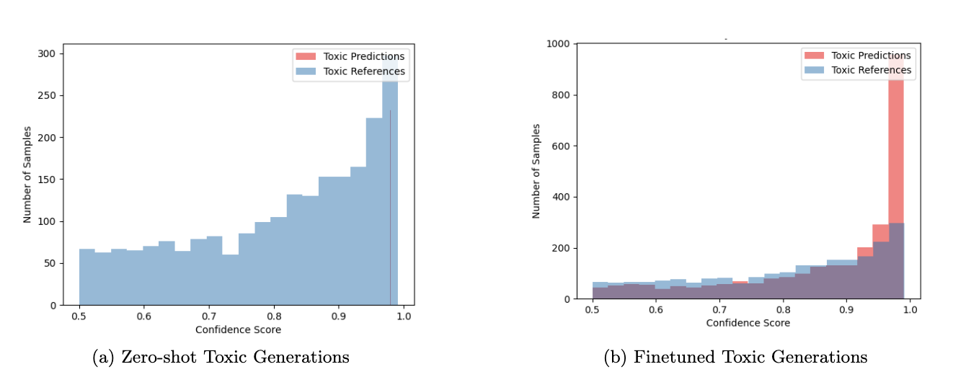
Reddit AITA Multiclass: Flan-T5 XXL
Change in Toxic Generations
20.5%
More toxic generations than top comment references

Slide 38
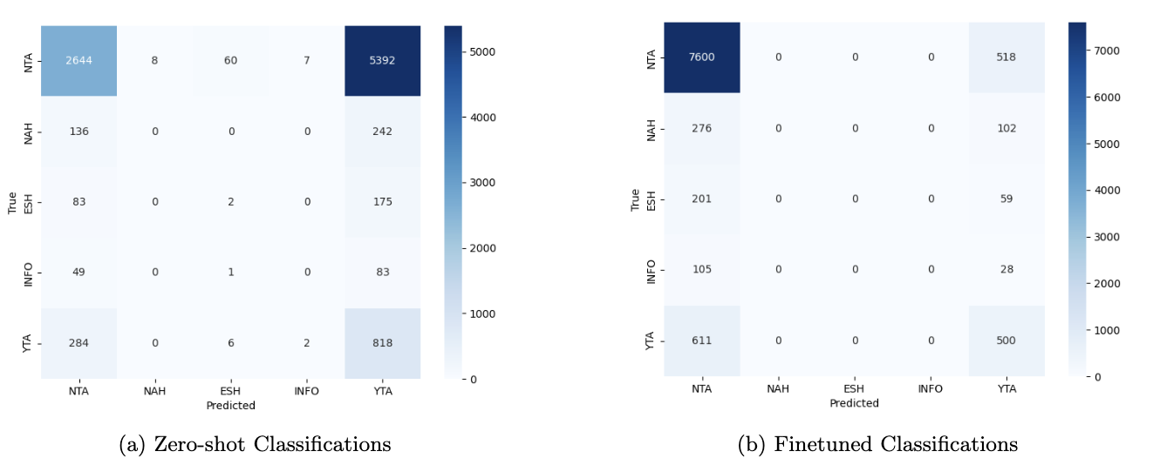
Change in AITA Classifications
Reduced to only selecting NTA/YTA (binary)

Slide 39
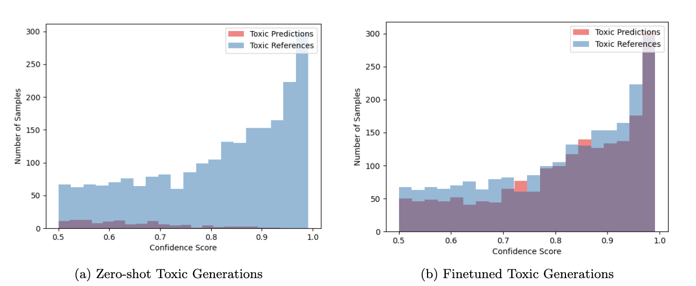
Reddit AITA Multiclass: Llama-2-13B-Chat
Change in Toxic Generations
17.8%
Consistently below reference top comment toxicity

Slide 40
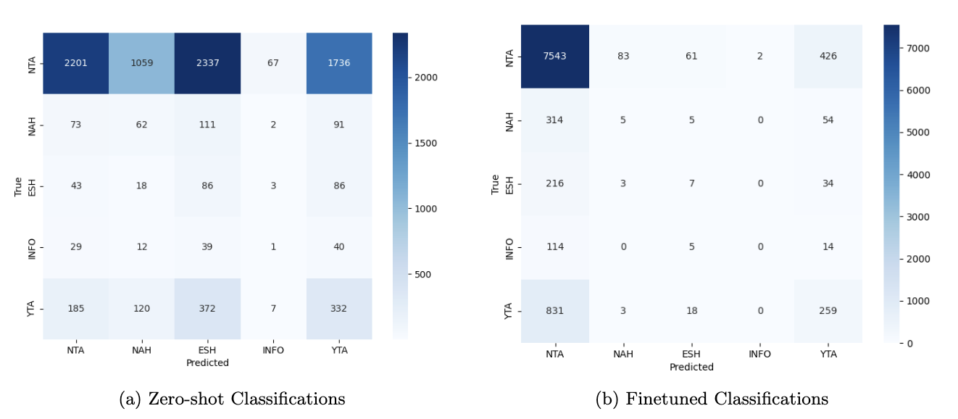
Change in AITA Classifications
Major, but not absolute, shift to NTA or YTA

Slide 41
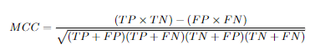
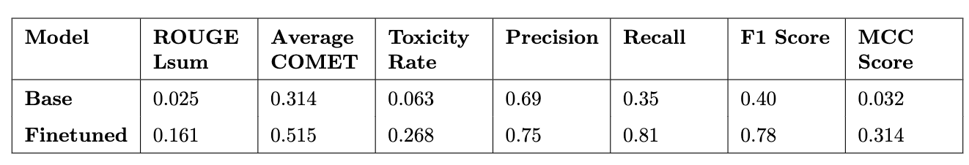
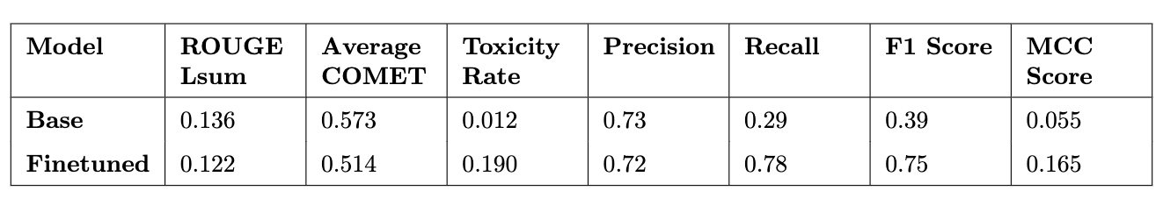
Reddit AITA Multiclass Performance Comparison
Reddit AITA Multiclass Reference Top Comment Toxicity Rate: 0.224
Finetuned Flan-T5 XXL is above this.
Finetuned Llama-2-13B-chat is below this.
Flan-T5-XXL
[6]
Llama-2-13B-Chat

Slide 42
Finetuning on Reddit AITA Multiclass Top 2K

Slide 43
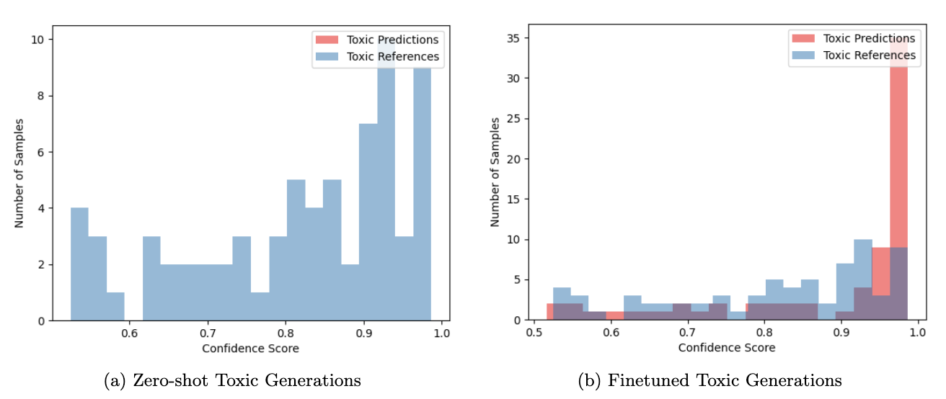
Reddit AITA Multiclass Top 2K: Flan-T5 XXL
Change in Toxic Generations
17.8%
More toxic generations than top comment references

Slide 44
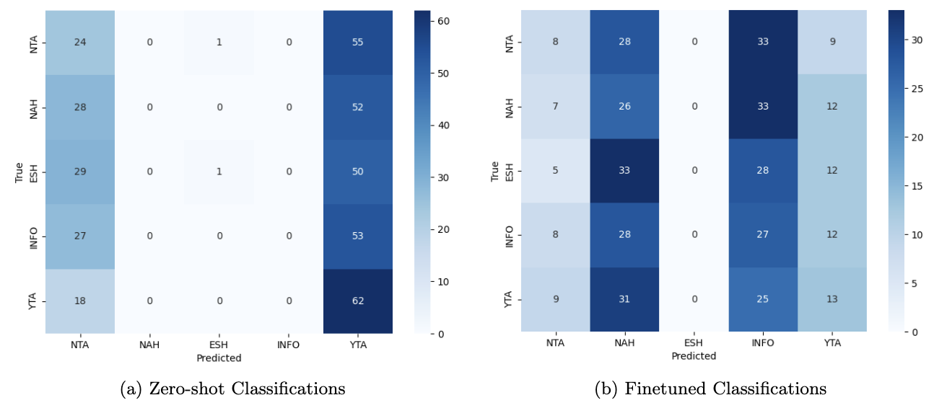
Model learned to select NAH and INFO heavily, but not accurately
Change in AITA Classifications

Slide 45
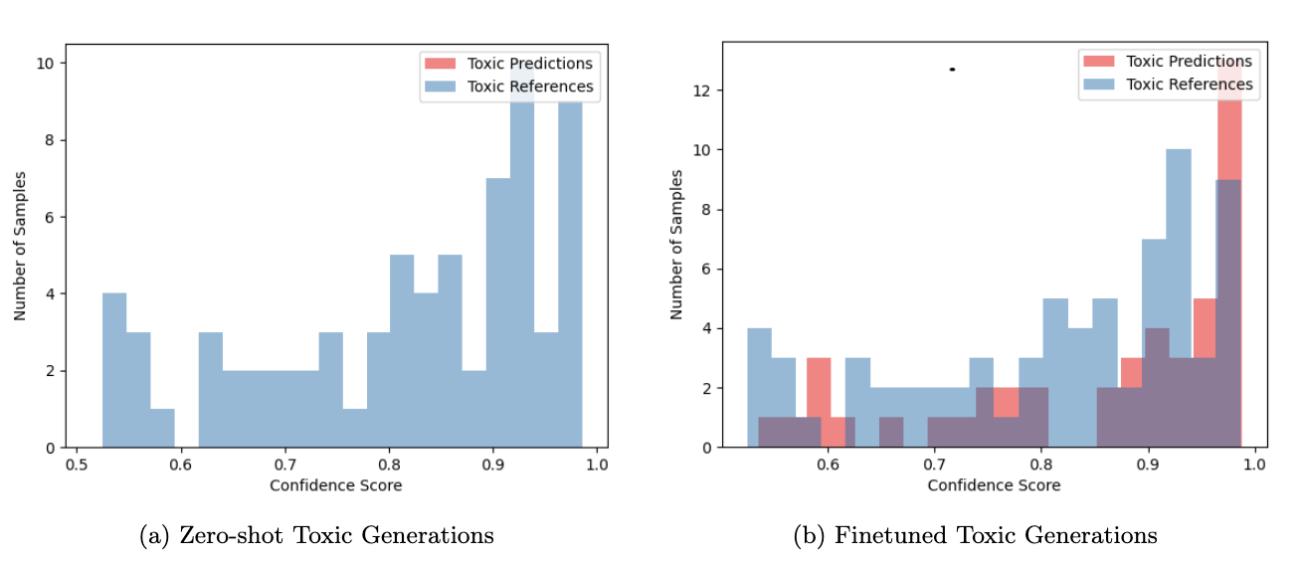
Reddit AITA Multiclass Top 2K: Llama-2-13B-Chat
Change in Toxic Generations
However, does exceed in number of highly confident toxic generations
11.3%
Overall, less toxic generations than references

Slide 46
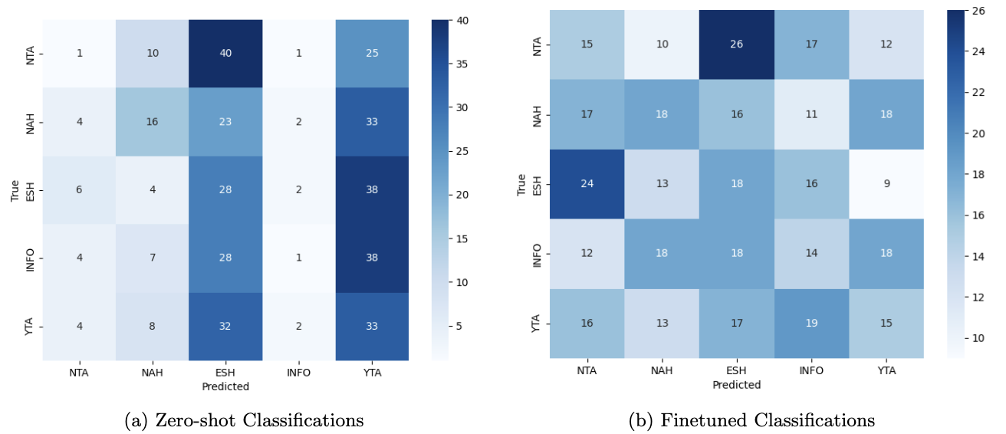
Classifications are scattered with no clear pattern
Change in AITA Classifications

Slide 47
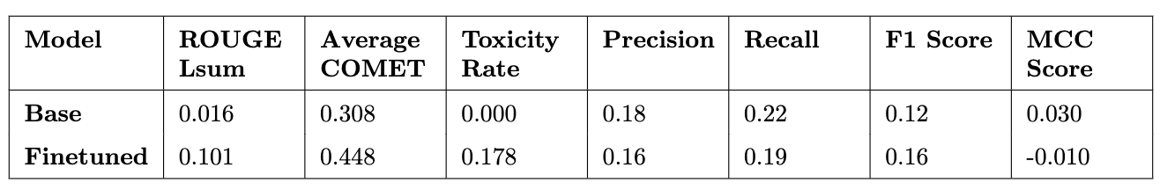
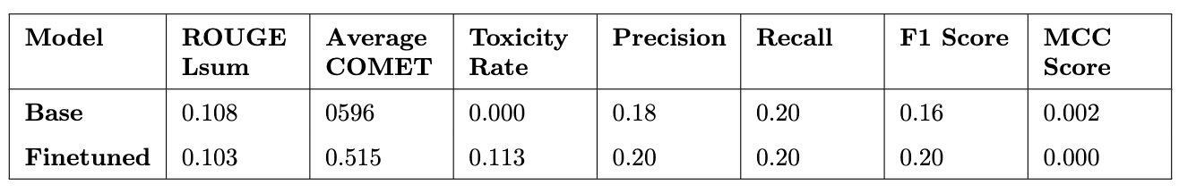
Reddit AITA Multiclass Top 2K Performance Comparison
Reference Top Comment Toxicity Rate: 0.178
No clear signs of improvement at expense of learning toxic language
Flan-T5-XXL
Llama-2-13B-Chat

Slide 48
Finetuning on Reddit AITA Binary

Slide 49
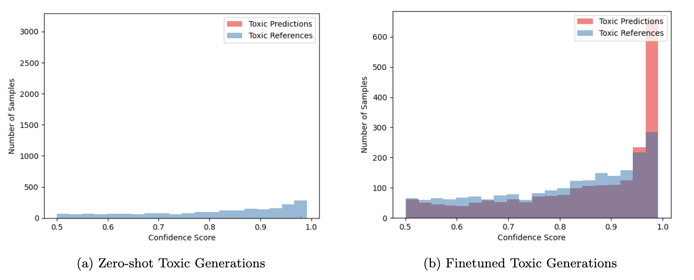
Reddit AITA Binary: Flan-T5 XXL
Change in Toxic Generations
23.5%
More toxic generations than top comment references

Slide 50
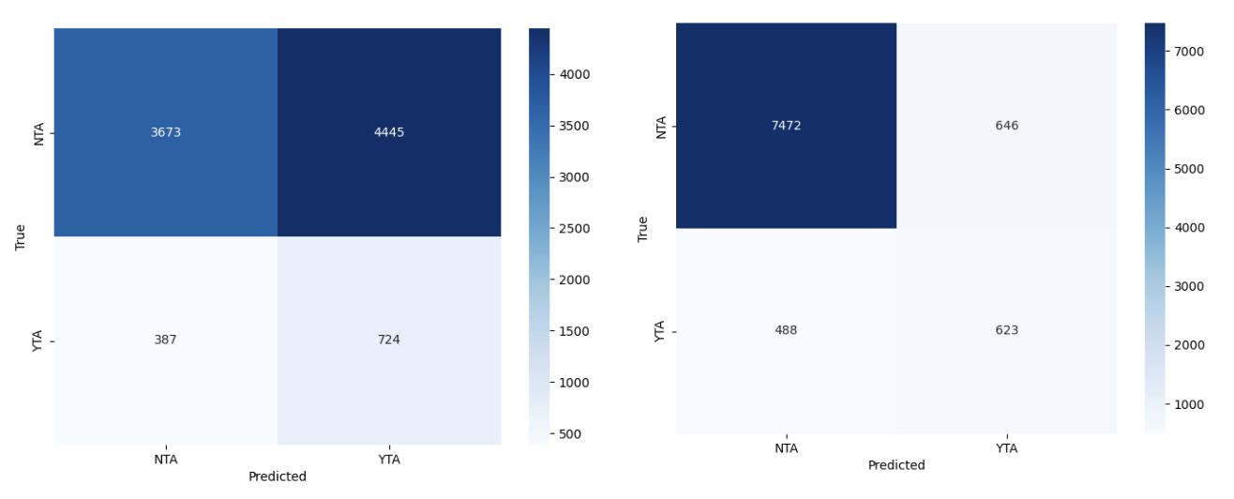
Majority of improvement came from learning to correctly identify NTA conflicts instead of misclassifying them as YTA
Change in AITA Classifications

Slide 51
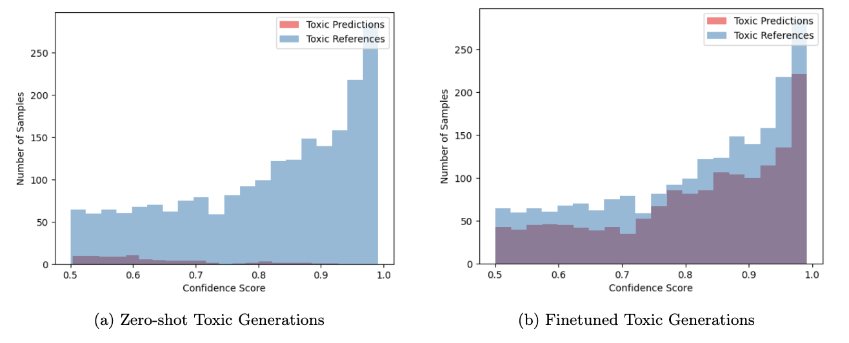
Reddit AITA Binary: Llama-2-13B-Chat
Change in Toxic Generations
15.6%
Consistently below reference top comment toxicity

Slide 52
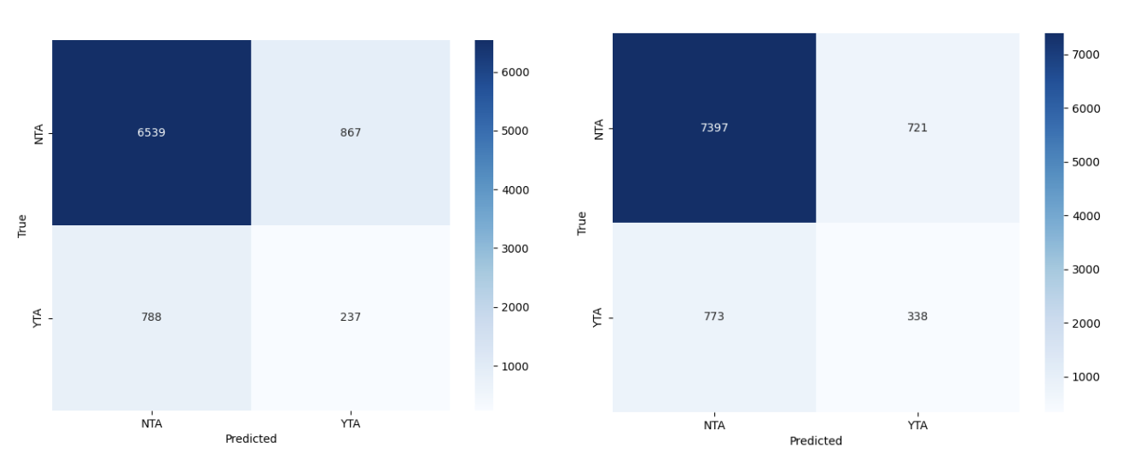
1. Correctly identifying NTA conflicts instead of misclassifying them as YTA
2. Giving NTA classifications to conflicts it previously failed to classify
Change in AITA Classifications

Slide 53
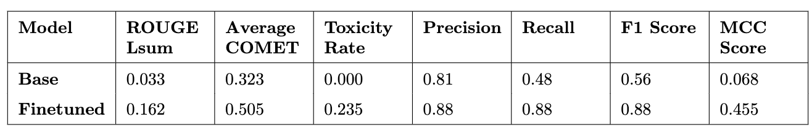
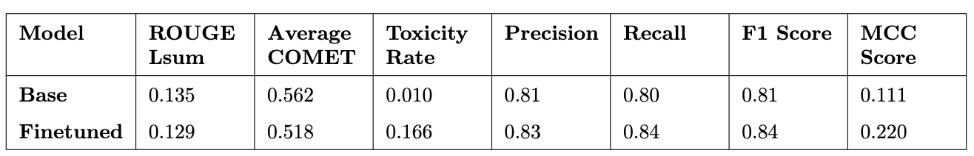
Reddit AITA Binary Performance Comparison
- Best performance across any model in classification was Flan-T5-XXL on this dataset
- Flan-T5-XXL achieved higher ROUGE Lsum, but base Llama-2-13B-Chat still maintained highest COMET score
Flan-T5-XXL
Llama-2-13B-Chat
Reference Top Comment Toxicity Rate: 0.231

Slide 54
Finetuning on Reddit AITA Binary Top 2K

Slide 55
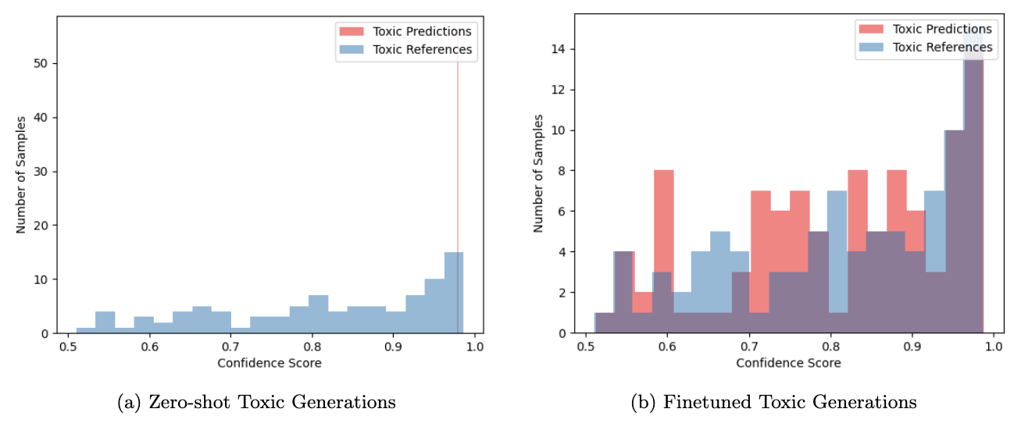
Reddit AITA Binary Top 2K: Flan-T5 XXL
Change in Toxic Generations
24.8%

Slide 56
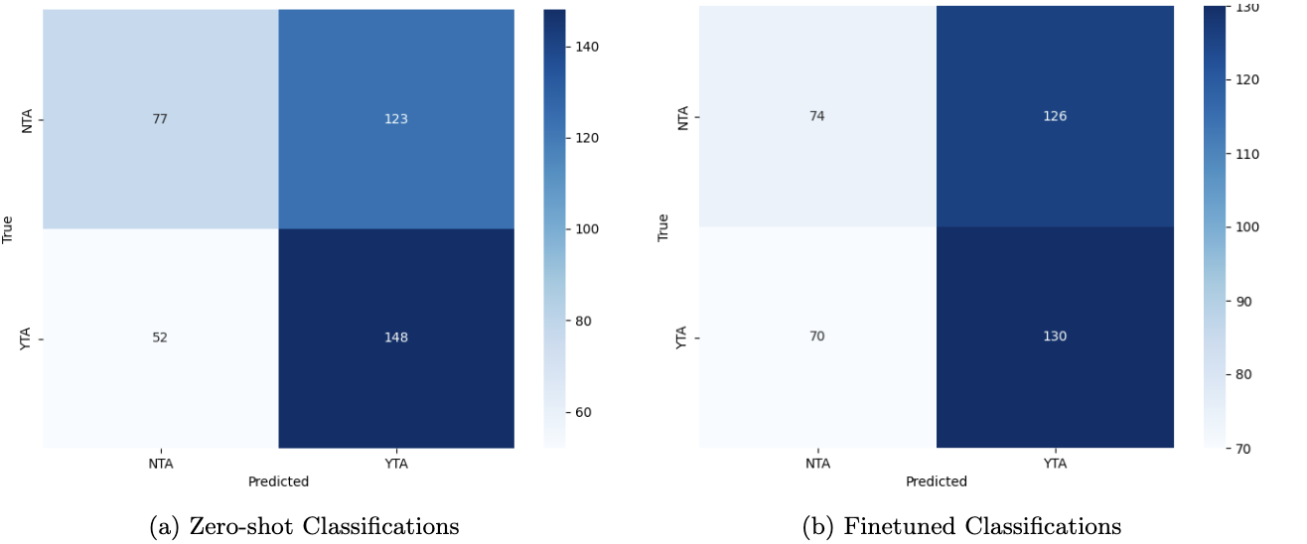
Decreases in accuracy for both NTA and YTA classifications
Change in AITA Classifications

Slide 57

Reddit AITA Binary Top 2K: Llama-2-13B-Chat
Change in Toxic Generations
18.8%

Slide 58

Decrease in accuracy for NTA classifications but increase for YTA ones
Change in AITA Classifications

Slide 59


Reddit AITA Binary Top 2K Performance Comparison
Reference Top Comment Toxicity Rate: 0.232
No clear signs of improvement at expense of learning toxic language
Flan-T5-XXL
Llama-2-13B-Chat

Slide 60
Key Insights From Finetuned Models
Both Flan-T5 and Llama-2-13B-Chat are not good at identifying the more nuanced AITA classifications of NAH, INFO, and ESH.
- Either fail or upon finetuning learn to not select these classes.
- Since most of interpersonal conflicts fall within NTA or YTA, are these other classes simply noise?
Higher ROUGE Lsum scores suggest that Flan-T5 is superior at classifications and learning the textual relationships on a lexical level.
Higher COMET scores and lower toxicity rates suggest that Llama-2-13B-Chat is superior at generating safer responses that are more agreeable with human judgements.
Lack of performance improvements on Top 2K datasets implies they are too small for quality learning.
Only 7.75%
of samples are
ESH, NAH, or INFO

Slide 61
How can we use this insights to to create ideal AI agents for interpersonal conflict resolution?
Encoder-decoder transformer architecture
Llama-2-Chat training methods

Slide 62
05
Proposed LLM Architecture and Finetuning Methodology for Interpersonal Conflict Resolution
What type of pretrained LLM should we use and what finetuning techniques should we use to optimize performance?

Slide 63

Prioritizes three objectives:
1. Justification Safety
2. Justification Quality
3. Classification Accuracy
2
3
1

Slide 64

Supervised Finetuning (SFT) on Benign Samples
Removal of toxic samples using a model finetuned using Toxigen dataset and domain-specific toxic slang
Encoder-decoder architecture for pretrained LLM
New training is also cleaned of toxic samples before new rounds of SFT

Slide 65
RLHF (Reinforcement Learning with Human Feedback)
Further align model with specific objectives.
Human Judges
1. Evaluate LLM on defined metrics and these are used to train reward model
LLM
LLM output
Policy parameterized as model weights
LLM output
Reward Model
2. Reward model generates a reward for the LLM output
Policy updates
via backpropogation
Reinforcement Learning (RL) Model
3. RL Model uses reward to calculate updates to LLM policy
Used during the training of Llama-2-Chat to improve safety.

Slide 66

Reward Model for RLHF
Separate reward model for each objective
Synthesized together using hierarchical learning
higher-level (safety) policies can override lower-level (justification quality and classification accuracy) when necessary

Slide 67



RLHF using Advantage Actor Critic (A2C)
Advantage Actor Critic (A2C) is an of actor-critic RL method, meaning that it combines the benefits of both value-based methods and policy-based methods.
A2C uses the advantage function A(s,a) to evaluate actions taken by the LLM.
The advantage function compares the value of taking a specific action in a particular state according to the reward model to the value of being in that state according to the critic.
Ideal for when multiples objectives are being optimized during RLHF.
'actor’ = policy function that selects actions → parameterized by LLM
‘critic’ = another model (ex. Deep Neural Network) evaluates the utility of the action

Slide 68
06
Conclusion
What did this research contribute?
What future work can be built upon it?

Slide 69
Two Types of LLMs…
which one is optimal for interpersonal conflict resolution?
Encoder-Decoder
Decoder-only
Flan-T5 is superior at classifications and equivalent in justification quality
Llama-2-13B-Chat is superior at generating safer, more ethical responses

Slide 70
Binary Classification is Sufficient for Interpersonal Conflict Resolution
Both LLMs when finetuned on Reddit AITA Multiclass considered ESH, NAH, and INFO as noise
Flan-T5-XXL finetuned on Reddit AITA Binary
Only 7.75%
of samples are
ESH, NAH, or INFO

Slide 71
Optimal Architecture and Finetuning Process for Interpersonal Conflict Resolution

Slide 72
Future Work
Other popular
encoder-decoder LLMs
Implementation of the Proposed LLM Architecture and Finetuning Process for Interpersonal Conflict Resolution
Experimentation on Other Encoder-Decoder LLM
Improvements to the Quality of the Reddit AITA Datasets
BERT
BART
Potential Methods to Improve Dataset Quality
Filtering the dataset to remove samples with ambiguous classifications
Stratification to ensure equal representation of NTA and YTA classes
- Manual inspection to verify that the classifications were appropriate.
OpenNMT

Slide 73


Thank you!
Questions?
Contact me at…
mb1020923@wcupa.edu
or
mattboraske@gmail.com

Slide 74
Figure and Equation References
[1] https://aiml.com/compare-the-different-sequence-models-rnn-lstm-gru-and-transformers/
[2] Ashish Vaswani, Noam Shazeer, Niki Parmar, Jakob Uszkoreit, Llion Jones, Aidan N Gomez, Lukasz Kaiser, and Illia Polosukhin. Attention is all you need. Advances in neural information processing systems, 30, 2017.
[3] Yang, S. D., Ali, Z. A., & Wong, B. M. Fluid-gpt (fast learning to understand and investigate dynamics with a generative pre-trained transformer): Efficient predictions of particle trajectories and erosion. Industrial & Engineering Chemistry Research, 62(37), 2023.
[4] Klaus Krippendorff. Computing krippendorff’s alpha-reliability, 2011.
[5] Mary L McHugh. Interrater reliability: the kappa statistic. Biochemia medica, 22(3):276–282, 2012.
[6] Davide Chicco and Giuseppe Jurman. The advantages of the matthews correlation coefficient (mcc) over f1 score and accuracy in binary classification evaluation. BMC genomics, 21:1–13, 2020.

Slide 75

Thesis Bibliography

Slide 76


Slide 77


Slide 78


Slide 79


Slide 80


Slide 81


Slide 82


